Slide 1



E-COMMERCE – CUSTOMER SEGMENTATION

Slide 2

PROBLEM STATEMENT
The Business Problem
E-commerce companies face challenges like:
Not knowing which customers are most valuable
High spending on marketing without targeted strategy
Difficulty retaining customers
One-size-fits-all offers that don’t work

Slide 3

INTRODUCTION
Understanding customers is at the heart of every successful e-commerce business. As online competition grows, companies need smarter ways to identify who their customers are, how they behave, and what drives their purchasing decisions.

Slide 4




Group customers based on their value and behavior
Create useful, meaningful segments for business decisions
used a few essential machine learning Unsupervised Machine Learning Algorithms.
APPROACH TO THE PROBLEM

Slide 5

K-MEANS
GMM
VISION
01
Creates hard clusters → each customer belongs to exactly one group
01
Creates soft clusters → customers can belong to multiple groups with probabilities
02
Works best when clusters are well-separated
02
More realistic for real-world customer overlap

Slide 6

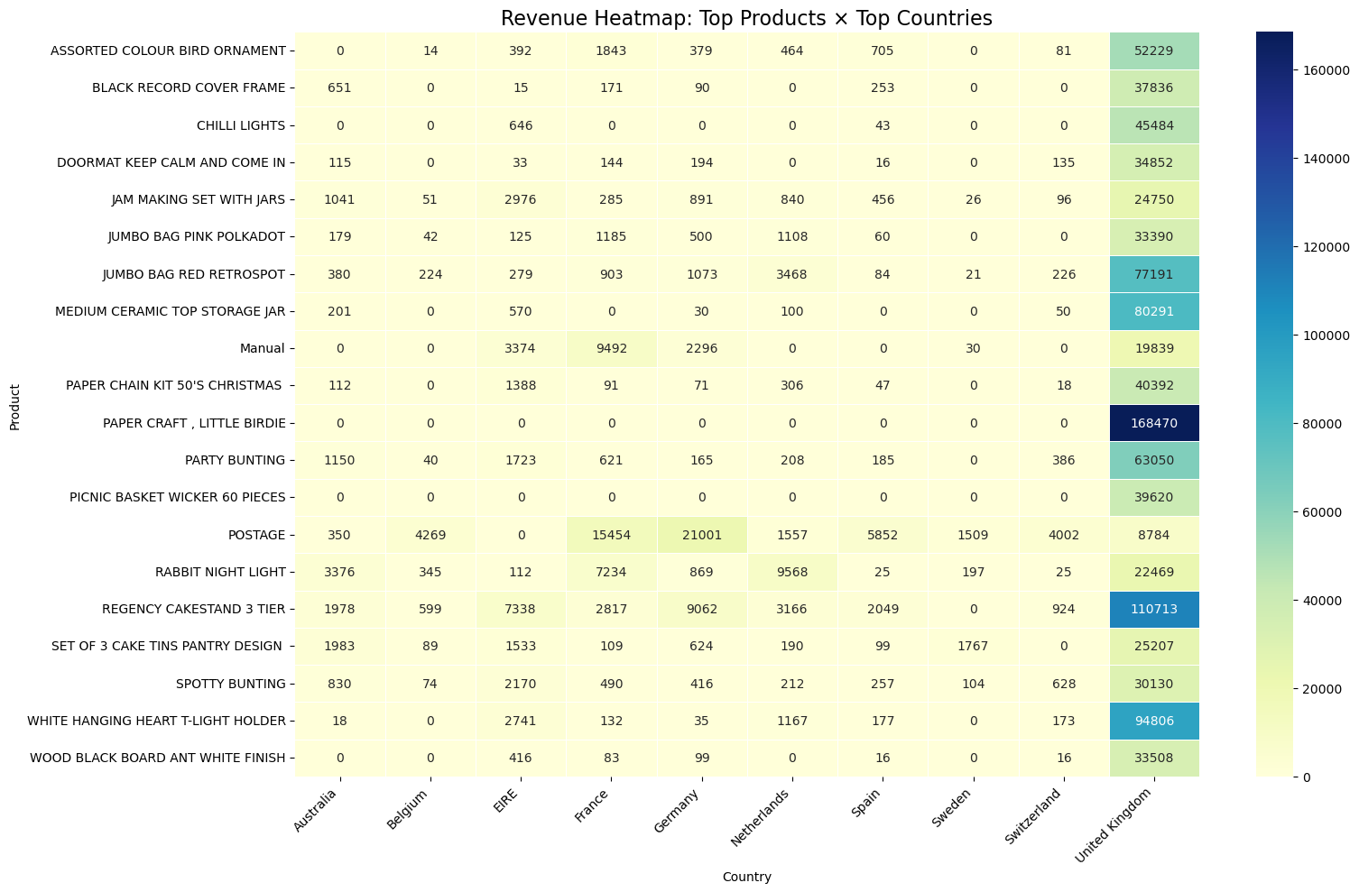

MARKET ANALYSIS

Slide 7
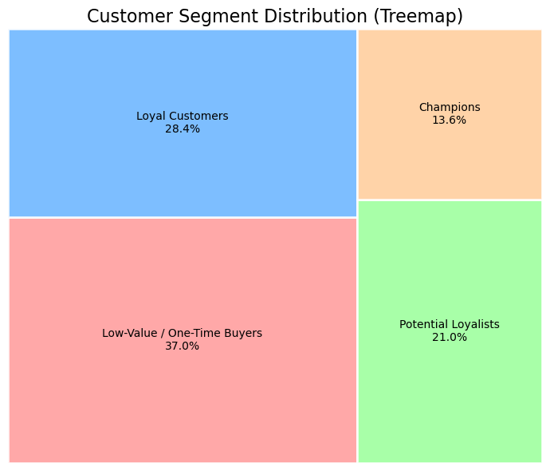
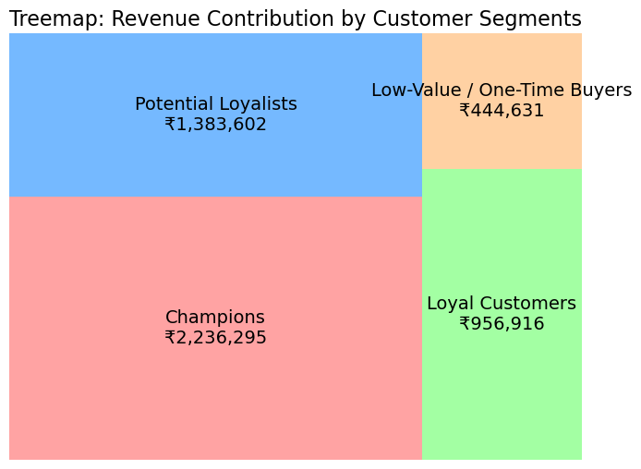
MARKET ANALYSIS

Slide 8

01
K-Means → Simple, stable clusters
USING BOTH GIVES A STRONGER VALIDATION
02
GMM → More flexible, probabilistic clusters
03
Using both helped us compare and choose the best segmentation for business decisions.

Slide 9
CONCLUSION & FINAL SOLUTION IMPACT
A CLEAR VIEW OF ITS CUSTOMER BASE
UNDERSTANDING OF WHO TO FOCUS ON
INSIGHTS TO IMPROVE SALES AND RETENTION

Slide 10
THANK YOU

